Slide 1
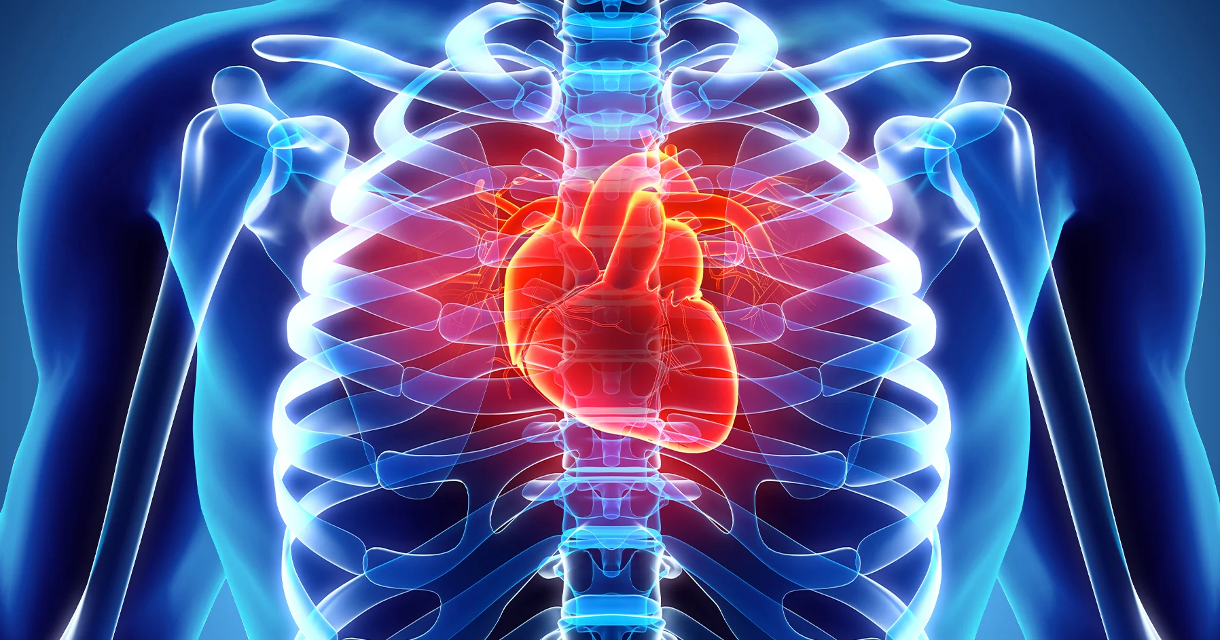
Cardiovascular Disease

Slide 2
Aman Nain
Bikky Singh
Jankiba Viralsinh Zala
Prakash Phakami Pun
Swetha Tanikonda
Rutul Mayankbhai Prajapati
Gaurav Singh
Tirth Patel
Yetunde Idiat Shittu
GROUP C

Slide 3
SCOPE OF PROJECT
The primary goal is to develop predictive models that can effectively identify individuals at risk of cardiovascular disease based on their health-related attributes. The dataset captures a diverse set of information, ranging from measurable physical characteristics to lifestyle choices, providing a holistic view for predictive analysis.
Cardiovascular diseases (CVDs) are a group of conditions that negatively impact the heart and blood vessels, making them a major cause of death and disability across the globe. These diseases, which include coronary heart disease and stroke, can be prevented or their onset delayed by addressing and mitigating the risk factors that contribute to their development.

Slide 4
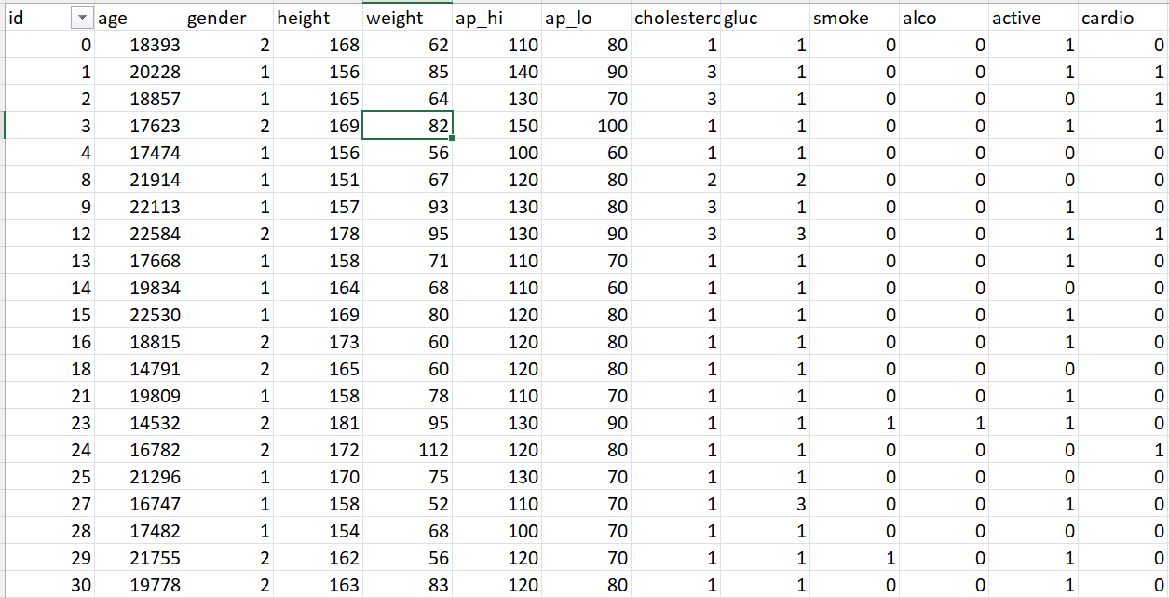
DATASET DESCRIPTION
Our data sets encompass a variety of formats and origins. It comprises 70,000 records of patient data, with 13 features and a target variable. The dataset is designed to provide insights into the presence or absence of cardiovascular disease based on various health-related factors.

Slide 5
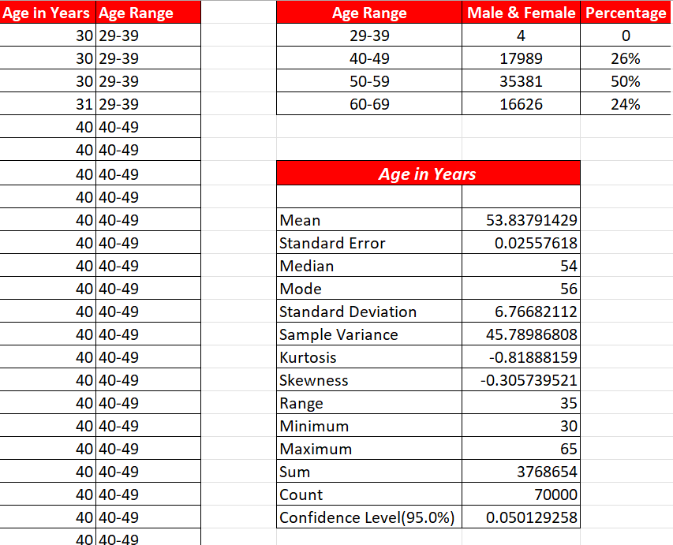
Age
Age is one of the most important risk factors for cardiovascular disease, as the risk increases with advancing age. This is because the aging process affects the structure and function of the heart and blood vessels, making them more prone to damage and disease

Slide 6
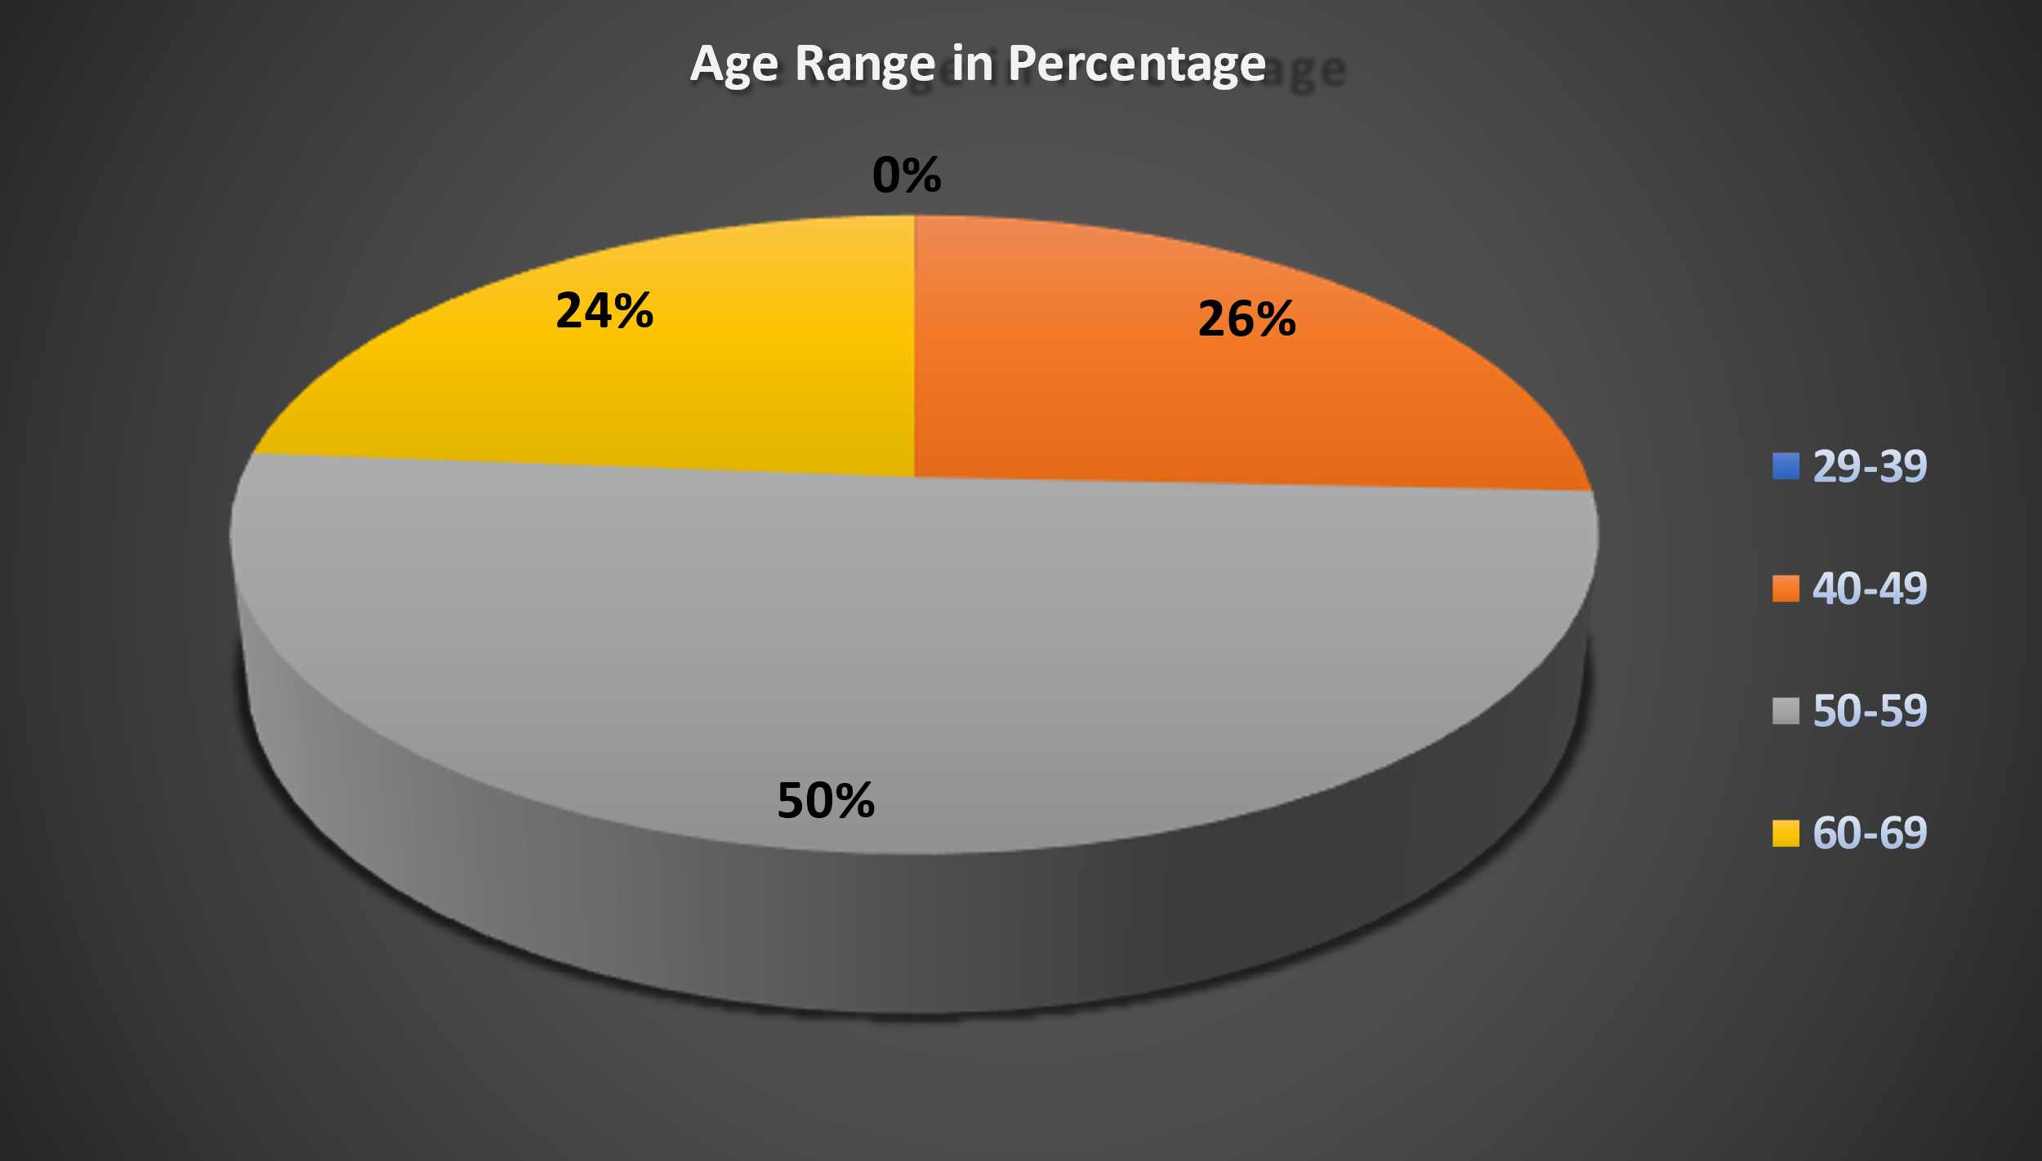

Slide 7
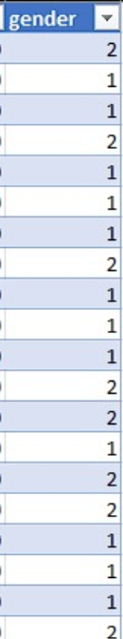
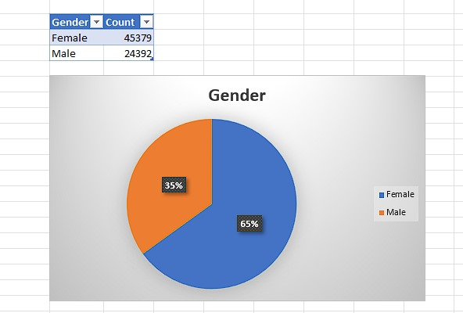
Gender
Gender is another important risk factor for cardiovascular disease, as men and women have different patterns and outcomes of the disease.
Men tend to develop the disease earlier and more severely than women and have a higher risk of dying from the disease. Women, on the other hand, tend to have more atypical symptoms and less effective treatments than men, and have a higher risk of complications and disability from the disease.
The differences between men and women may be due to biological, hormonal, behavioral, and social factors that affect the development and progression of the disease.

Slide 8
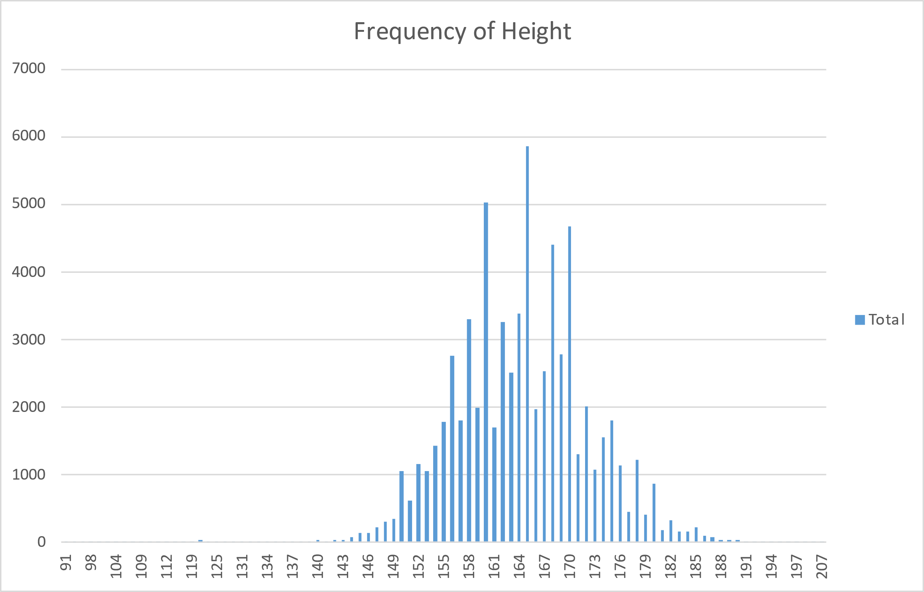
HEIGHT
Height may have a modest influence on the risk of cardiovascular disease, as some studies have suggested that taller people have a lower risk than shorter people.
However, the effect of height is not very strong and may be confounded by other factors, such as body weight, diet, and physical activity.

Slide 9
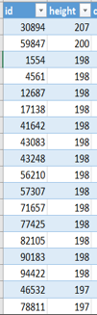

HEIGHT

Slide 10
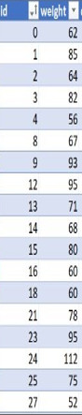

WEIGHT
Weight, or more specifically, body mass index (BMI), is a measure of body fatness that can affect the risk of cardiovascular disease.
Losing weight can lower the risk of cardiovascular disease and improve the quality of life.

Slide 11
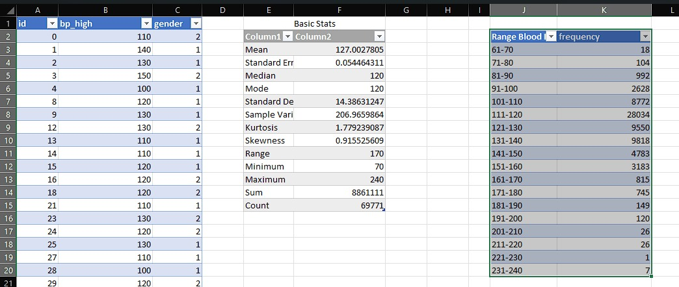
Systolic blood pressure(ap_hi)
Systolic blood pressure is the pressure of blood against the artery walls when the heart contracts.
Systolic blood pressure is a major risk factor for cardiovascular disease, as high systolic blood pressure, or hypertension, can damage the arteries, the heart, and other organs, and increase the risk of heart attack, stroke, heart failure, and kidney disease.

Slide 12
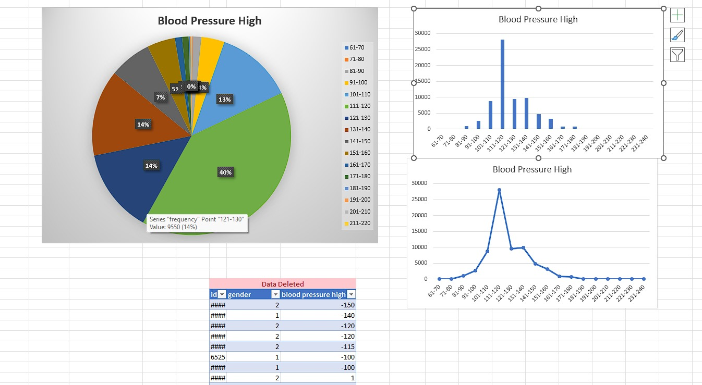

Slide 13
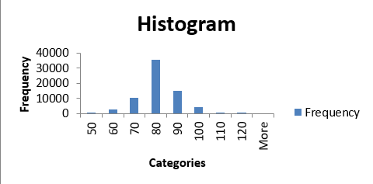
Systolic blood pressure(ap_lo)
Diastolic blood pressure is the pressure of blood against the artery walls when the heart relaxes. It is the lower of the two numbers in a blood pressure reading, and is usually written second, such as 120/80 mmHg.
Diastolic blood pressure is also a risk factor for cardiovascular disease, but less than systolic blood pressure. High diastolic blood pressure, or hypertension, can also damage the arteries, the heart, and other organs, and increase the risk of cardiovascular events.

Slide 14
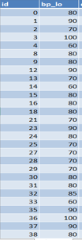
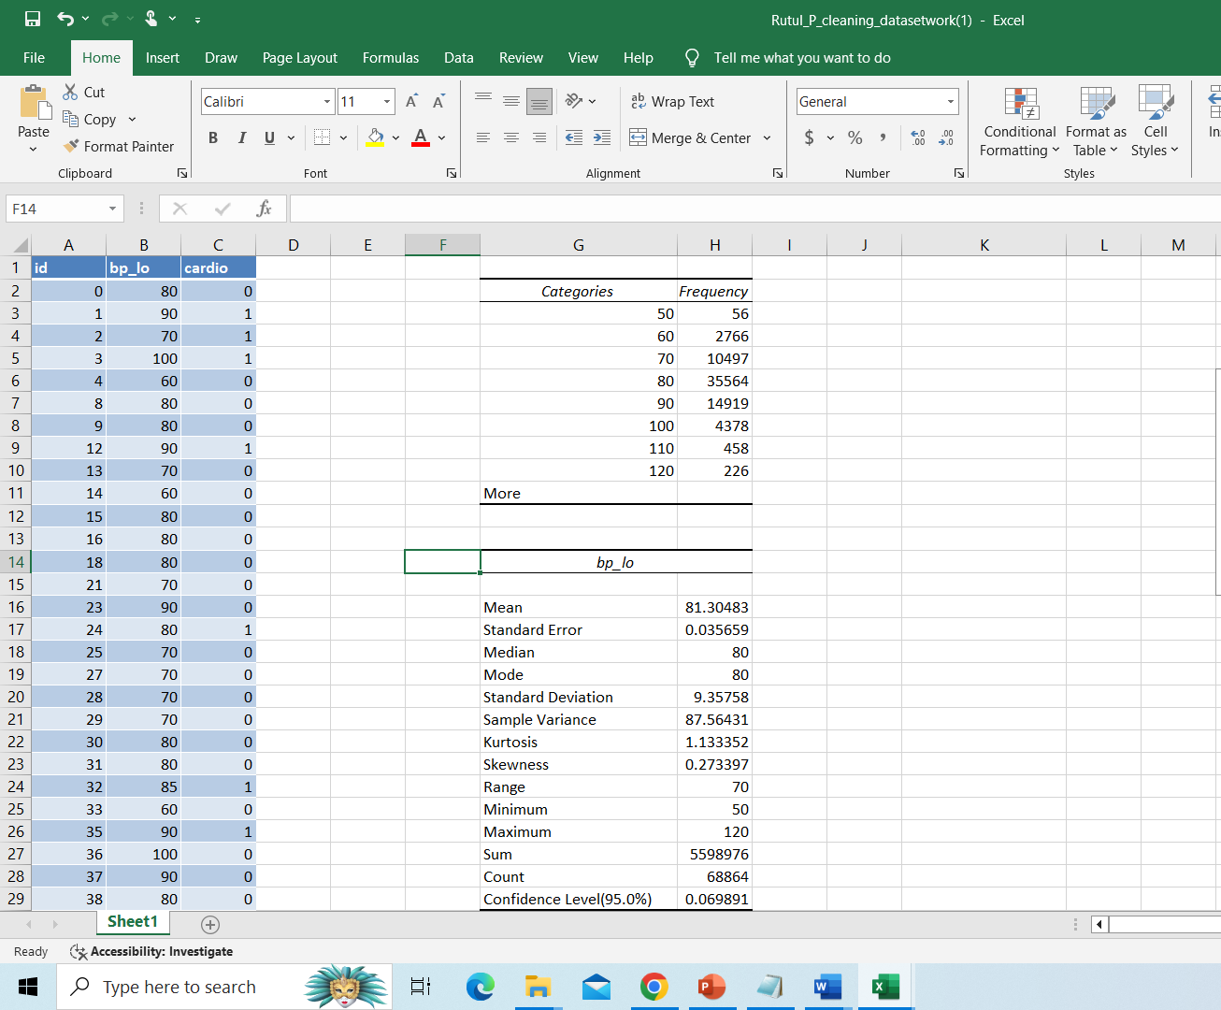
Systolic blood pressure(ap_lo)

Slide 15
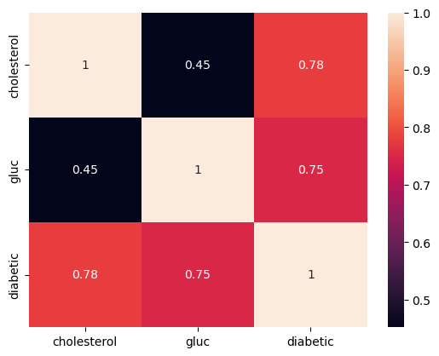
CHOLESTEROL
Cholesterol is a type of fat that circulates in the blood and is essential for many bodily functions.
However, too much of the bad cholesterol (LDL) or too little of the good cholesterol (HDL) can increase the risk of cardiovascular disease by forming plaques in the arteries that can narrow or block the blood flow to the heart and brain.

Slide 16
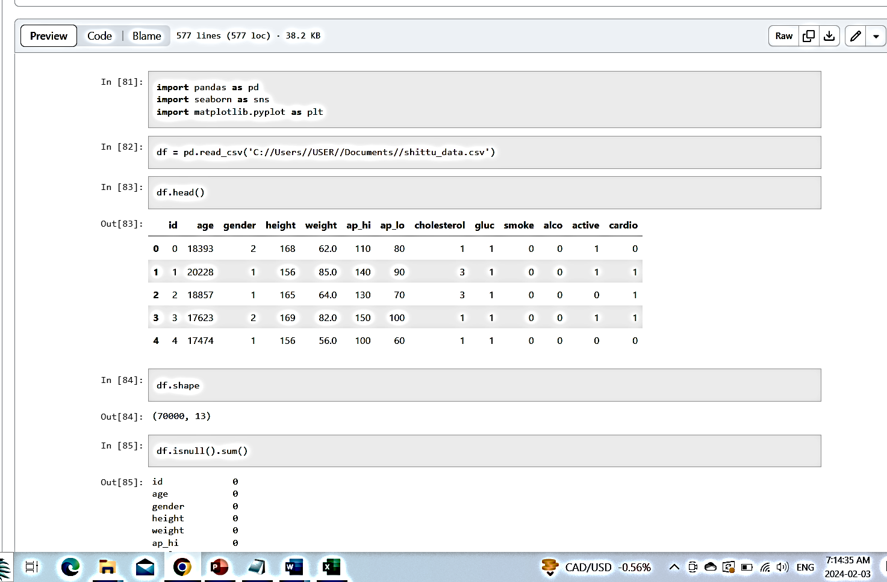
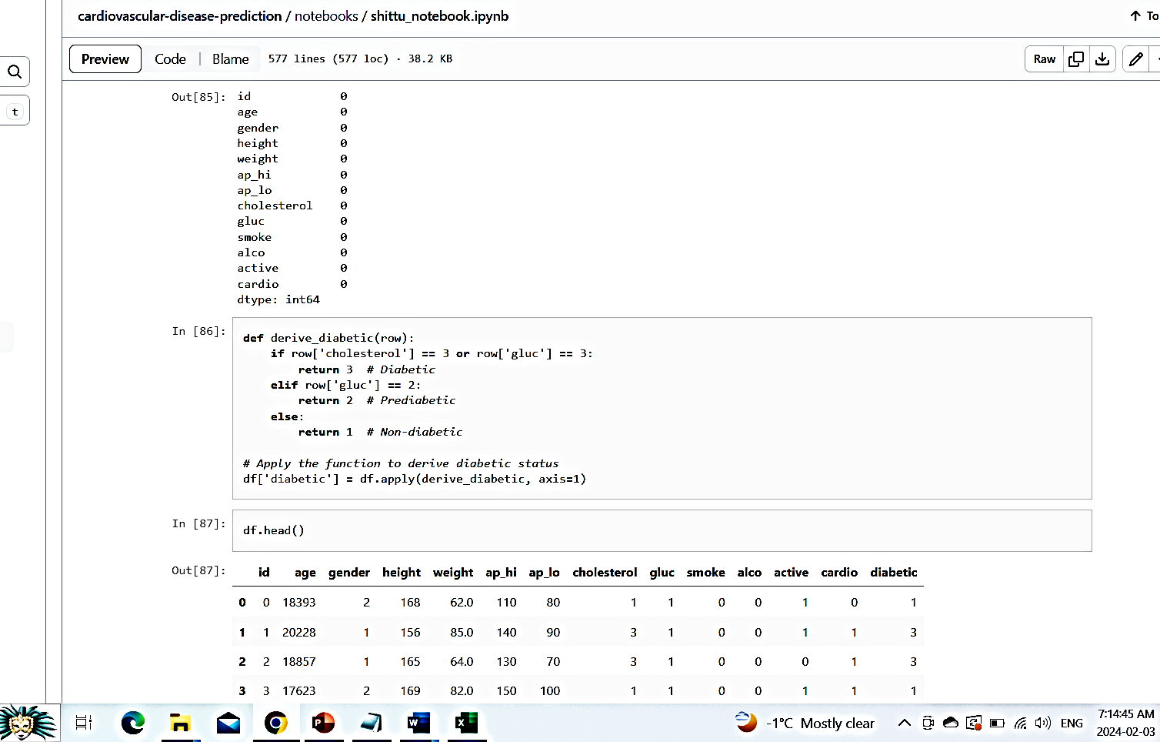
CHOLESTEROL

Slide 17
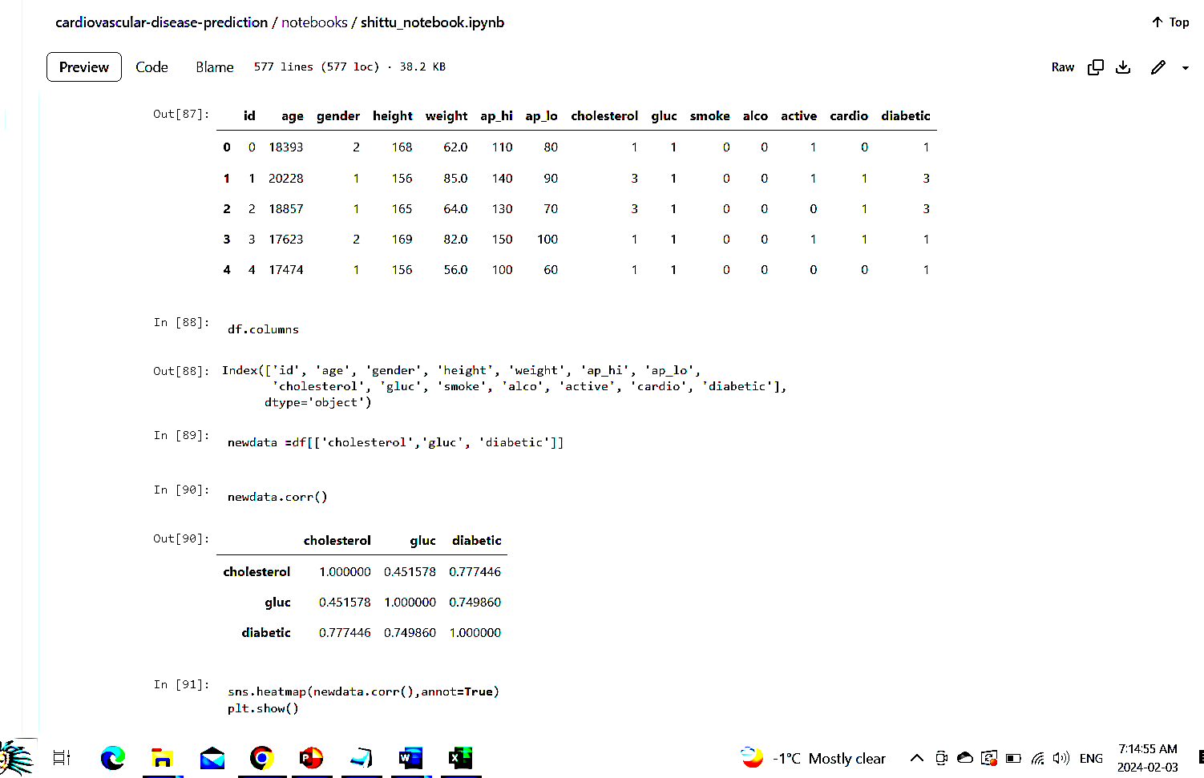

Slide 18
GLUCOSE
Glucose is a type of sugar that is the main source of energy for the cells. Glucose levels in the blood are regulated by the hormone insulin, which is produced by the pancreas.
High glucose levels, or hyperglycemia, can occur when the body does not produce enough insulin or does not use it properly, as in diabetes.
High glucose levels can damage the blood vessels and nerves, and increase the risk of cardiovascular disease, especially in people with diabetes.

Slide 19

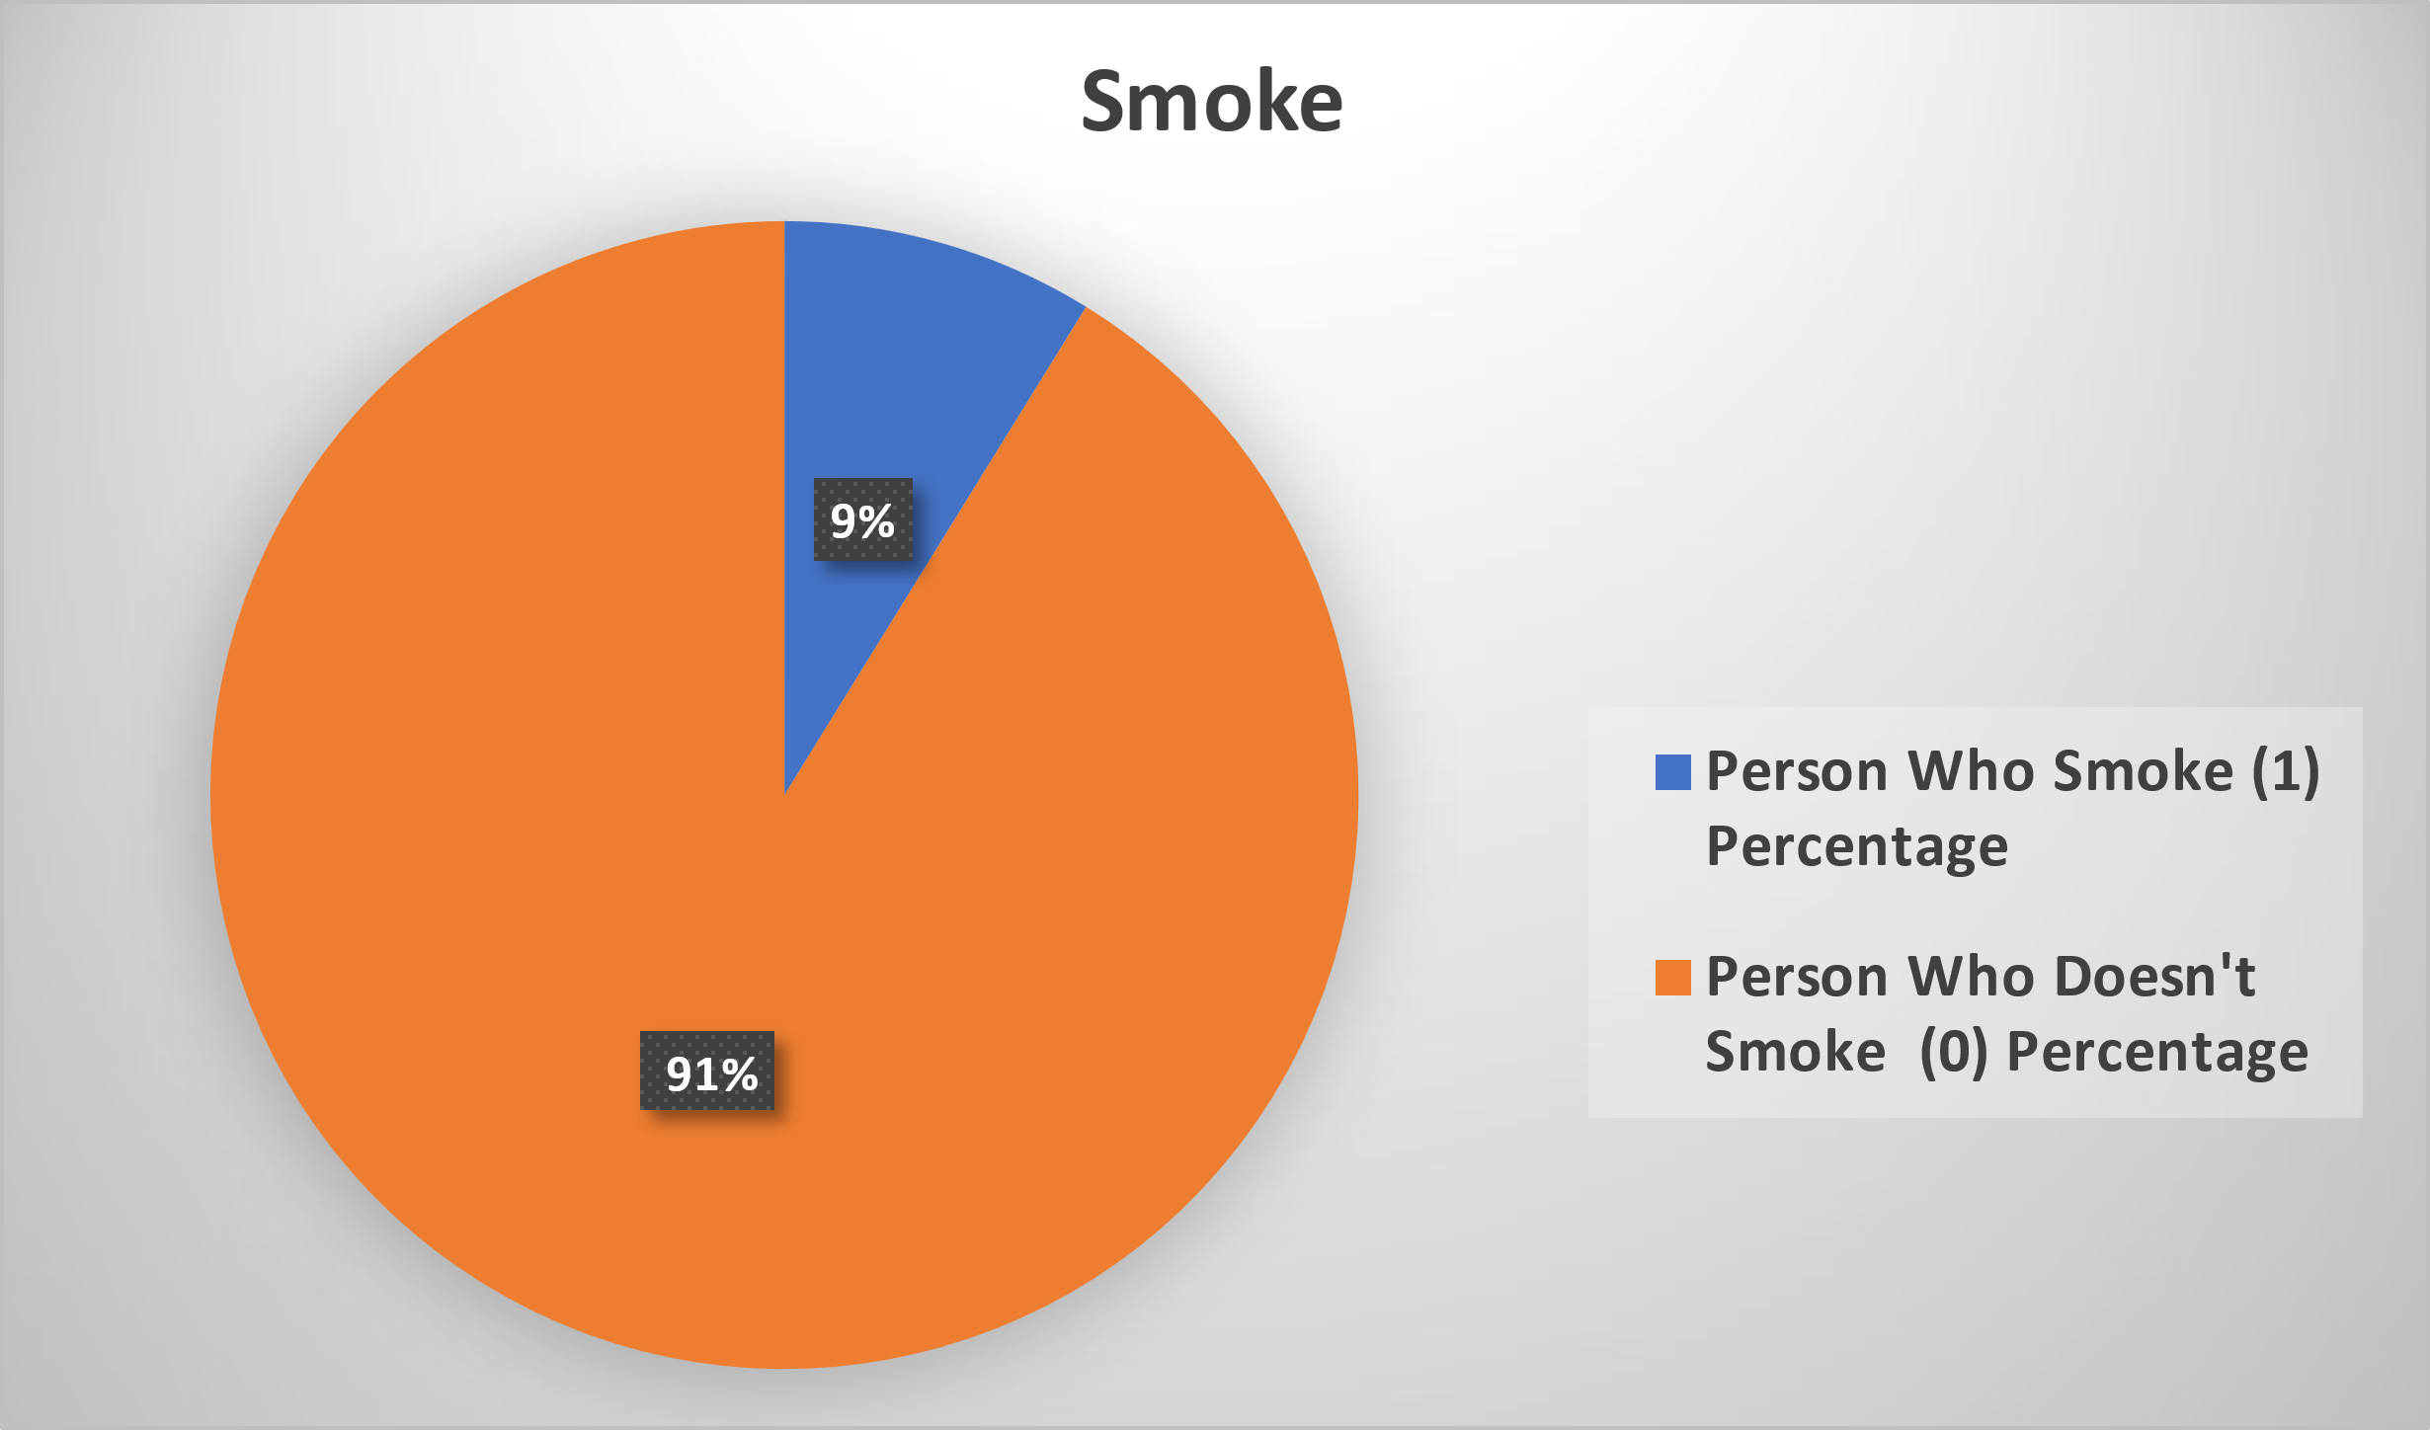
SMOKE
Smoking is one of the most important modifiable risk factors for cardiovascular disease, as smoking damages the lining of the arteries, increases blood pressure and heart rate, reduces oxygen supply to the heart, and increases the risk of blood clots.

Slide 20
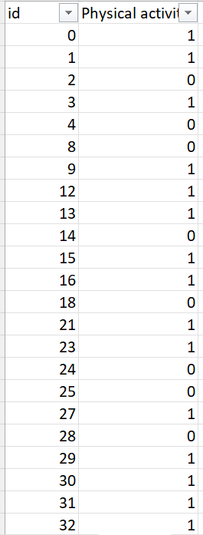
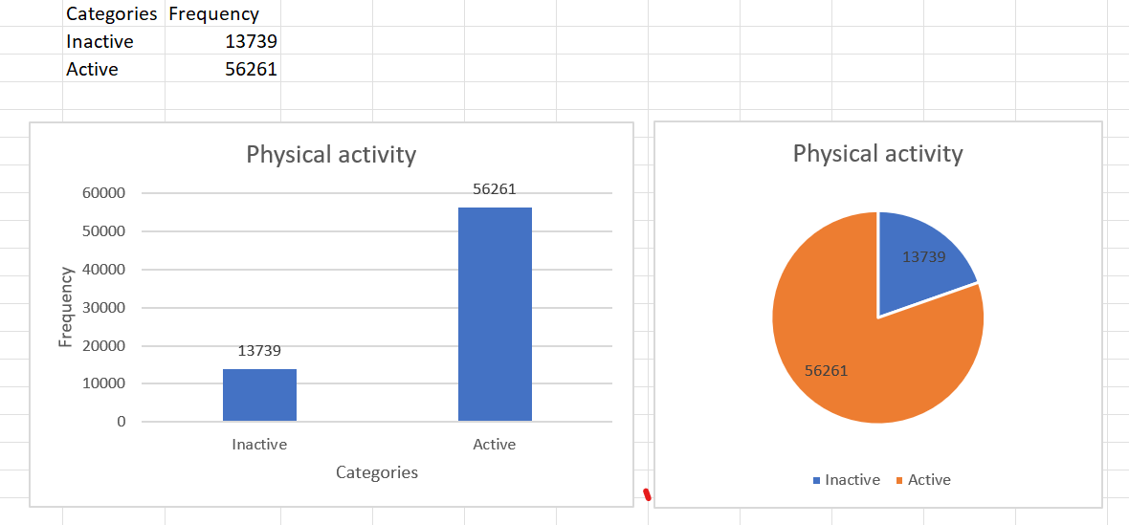
Physical activity(Active)
Physical activity is one of the most beneficial lifestyle factors for preventing and managing cardiovascular disease, as physical activity can improve cardiovascular fitness, lower blood pressure, control blood sugar, prevent obesity, reduce stress, and enhance mood.
The American Heart Association recommends at least 150 minutes of moderate-intensity aerobic exercise or 75 minutes of vigorous-intensity aerobic exercise per week for adults, and at least 60 minutes of moderate-to-vigorous physical activity per day for children and adolescents.

Slide 21
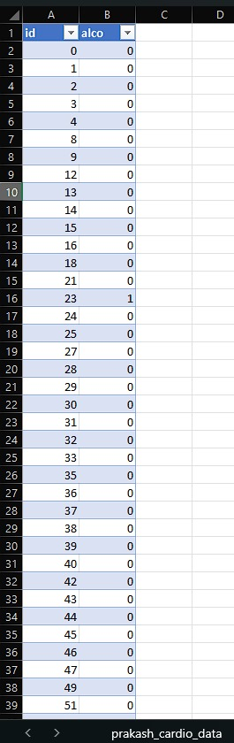
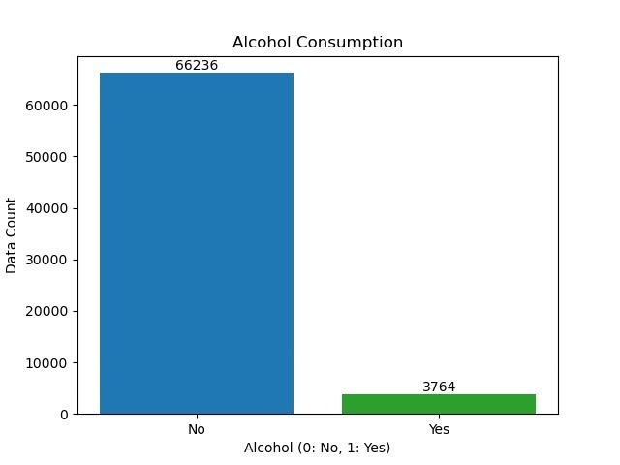
Alcohol
Alcohol intake can have both beneficial and harmful effects on the risk of cardiovascular disease, depending on the amount and frequency of consumption. Moderate alcohol intake, defined as up to one drink per day for women and up to two drinks per day for men, may have a protective effect on the risk of cardiovascular disease, by increasing HDL cholesterol, reducing blood clotting, and lowering stress.
However, excessive alcohol intake, defined as more than three drinks per day for women and more than four drinks per day for men, can have a detrimental effect on the risk of cardiovascular disease, by increasing blood pressure, triglycerides, weight, and inflammation, and by causing irregular heartbeats, cardiomyopathy, and stroke.

Slide 22
Data Resources
[https://www.kaggle.com/datasets/sulianova/cardiovascular-disease-dataset](https://www.kaggle.com/datasets/sulianova/cardiovascular-disease-dataset)

Slide 23
Thank You

